Slide 1

Final Project Report
Retail Forecasting Project
02/01/2023
Gao Mo

Slide 2
Agenda
Model Deliverables
Model Selection
Model Performance
Feature Importance Summary

Slide 3
4 multivariate forecasting model
One base model, one linear model, one ensemble model, one boosting model
Demonstrate explainability in the form of contribution of each variables
Model Deliverables

Slide 4
Base Model: Linear Regression
Linear Model: Support Vector Machine with linear kernels
Ensemble Model: Random Forest
Boosting model: Gradient Boosting Regressor
Model Selection

Slide 5
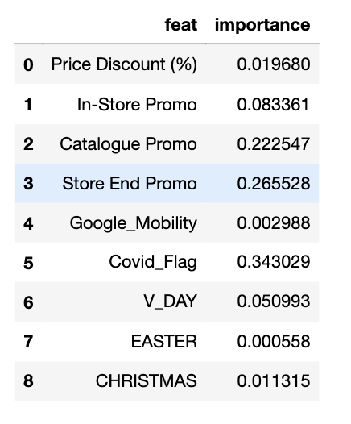
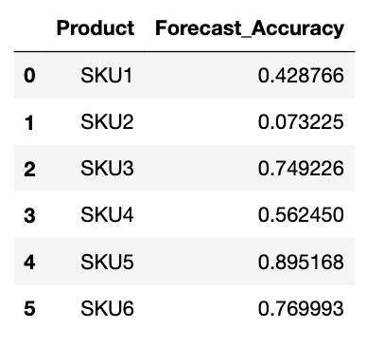
Model Performance (Base Model)
Feature Importance
Model Accuracy

Slide 6
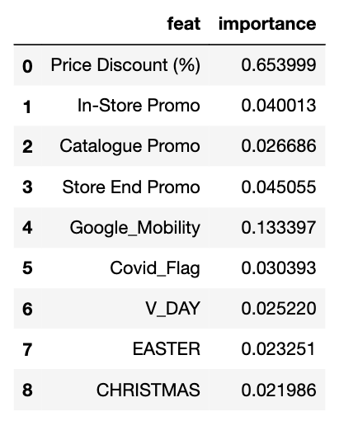
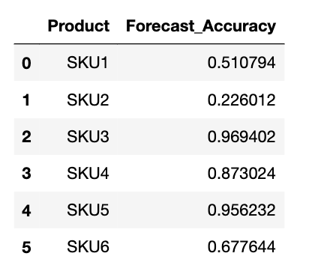
Model Performance (Ensemble Model)
Feature Importance
Model Accuracy

Slide 7
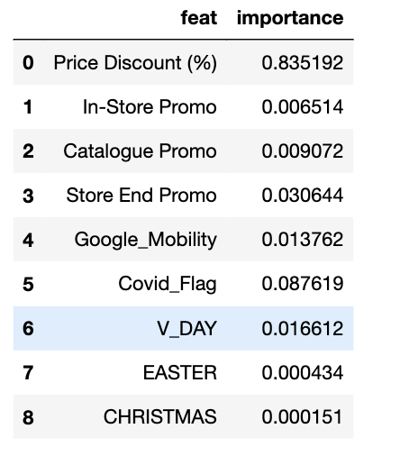
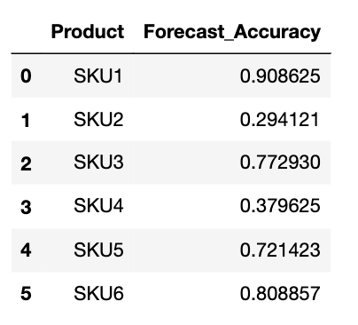
Model Performance (Boosting Model)
Feature Importance
Model Accuracy

Slide 8
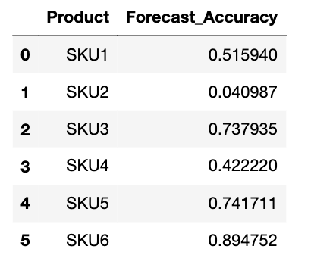
Model Performance (Linear Model)
Feature Importance
Model Accuracy

Slide 9
Among all the features, the percentage of price discount has the highest average feature importance value among all the models, which shows that it is significantly more important than other features
The second highest feature is whether COVID is in play, which is also worthing noting
Feature Importance

Slide 10
In summary, by comparing the model performance, ensemble model has a higher accuracy among all different model selected for this study. Therefore, the recommendation to replace the in-house forecasting model will be Random Forest ensemble model
Summary

Slide 11
Thank You

